Slide 2
Accidental Satanism
Who Will You Serve?

Slide 3
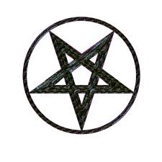
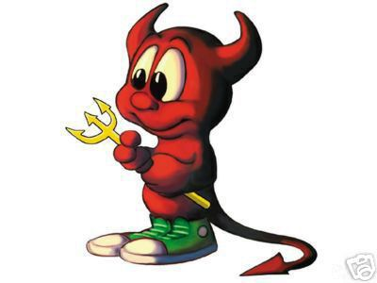
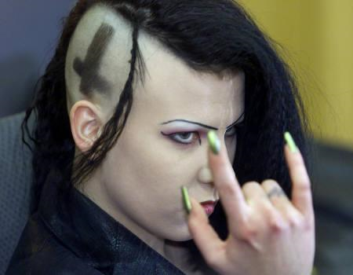
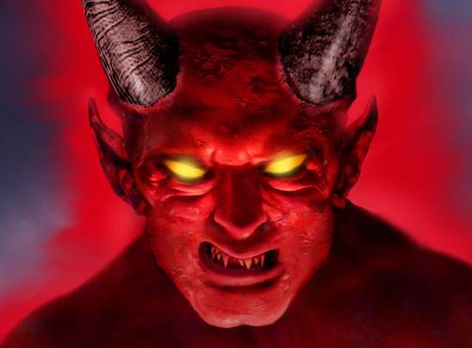
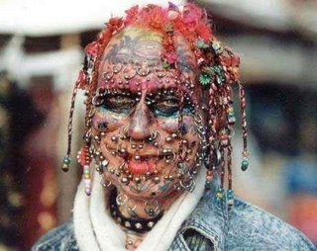
Introduction
Common conception of Satanism

Slide 4
Introduction
2 Corinthians 13:5
5 Examine yourselves as to whether you are in the faith. Test yourselves. Do you not know yourselves, that Jesus Christ is in you?—unless indeed you are disqualified.
Consider a different kind of “Satanism”
Definition
–noun
1. the worship of Satan or the powers of evil.
2. a travesty of Christian rites in which Satan is worshiped.
3. diabolical or satanic disposition, behavior, or activity.
Consider incidental, accidental Satanism
Are you a Satanist?

Slide 5
The Two Kingdoms
1 John 1:5-7: ⁵This is the message which we have heard from Him and declare to you, that God is light and in Him is no darkness at all. ⁶If we say that we have fellowship with Him, and walk in darkness, we lie and do not practice the truth. ⁷But if we walk in the light as He is in the light, we have fellowship with one another, and the blood of Jesus Christ His Son cleanses us from all sin.
1 John 2:7-11: ⁷Brethren, I write no new commandment to you, but an old commandment which you have had from the beginning. The old commandment is the word which you heard from the beginning. ⁸Again, a new commandment I write to you, which thing is true in Him and in you, because the darkness is passing away, and the true light is already shining. ⁹He who says he is in the light, and hates his brother, is in darkness until now. ¹⁰He who loves his brother abides in the light, and there is no cause for stumbling in him. ¹¹But he who hates his brother is in darkness and walks in darkness, and does not know where he is going, because the darkness has blinded his eyes.
Ephesians 5:8: ⁸For you were once darkness, but now you are light in the Lord. Walk as children of light
Two kingdoms in the spiritual realm
Kingdom of light, and kingdom of darkness
These kingdoms are diametrically opposed

Slide 6
The Two Kingdoms
Matthew 6:33: ³³But seek first the kingdom of God and His righteousness, and all these things shall be added to you.
Matthew 12:28: ²⁸But if I cast out demons by the Spirit of God, surely the kingdom of God has come upon you.
Matthew 4:17: ¹⁷From that time Jesus began to preach and to say, “Repent, for the kingdom of heaven is at hand.”
God is the ruler of the kingdom of light
Satan is the ruler of the kingdom of darkness
Acts 26:15-18

Slide 7
Acts 26:15-18
Open Eyes
from
from
Darkness
Parallel
Satan
to
to
Light
Parallel
God

Slide 8
The Two Kingdoms
John 12:31: ³¹Now is the judgment of this world; now the ruler of this world will be cast out.
John 14:30: ³⁰I will no longer talk much with you, for the ruler of this world is coming, and he has nothing in Me.
2 Corinthians 4:3-4: ³But if our gospel be hid, it is hid to them that are lost: ⁴In whom the god of this world hath blinded the minds of them which believe not, lest the light of the glorious gospel of Christ, who is the image of God, should shine unto them.
God is the ruler of the kingdom of light
Satan is the ruler of the kingdom of darkness
Acts 26:15-18
He is the ruler of this world

Slide 9
The Two Kingdoms
1 Peter 5:8-9: ⁸Be sober, be vigilant; because your adversary the devil walks about like a roaring lion, seeking whom he may devour. ⁹Resist him, steadfast in the faith, knowing that the same sufferings are experienced by your brotherhood in the world.
Satan is real!
Ephesians 6:10-17
When we think of Satan as “not real”
We don’t think of his work as real
We don’t guard against trials and temptations
We think there is no consequence for sin
We may think that God is not real

Slide 10
The Two Kingdoms
Through the sacrifice of Christ we are transferred from darkness to light
Colossians 1:9-14
Obedience gives us access to the blood of Christ
Romans 6:15-17

Slide 11
Kingdom of Satan
1 John 3:4: ⁴Whoever commits sin also commits lawlessness, and sin is lawlessness.
1 Corinthians 6:9-11: ⁹Do you not know that the unrighteous will not inherit the kingdom of God? Do not be deceived. Neither fornicators, nor idolaters, nor adulterers, nor homosexuals, nor sodomites, ¹⁰nor thieves, nor covetous, nor drunkards, nor revilers, nor extortioners will inherit the kingdom of God. ¹¹And such were some of you. But you were washed, but you were sanctified, but you were justified in the name of the Lord Jesus and by the Spirit of our God.
Satan is:
The god of this world
The ruler of this world
His realm is worldliness!
Sinful practices
Sin: to miss the mark
Continuing in sin excludes one from God’s kingdom

Slide 12
Kingdom of Satan
Ephesians 5:1-7
Practices originate in the heart
Matthew 12:33-37
Kingdoms have different “wisdom”
James 3:13-18
Wisdom that reflects worldliness is “demonic”
Wisdom from above is pure, peaceable, gentle…

Slide 13
Kingdom of God
John 8:44: ⁴⁴You are of your father the devil, and the desires of your father you want to do. He was a murderer from the beginning, and does not stand in the truth, because there is no truth in him. When he speaks a lie, he speaks from his own resources, for he is a liar and the father of it.
Opposite of the kingdom of Satan
Citizens of this kingdom act differently
Ephesians 5:8-14
1 Thessalonians 5:1-11
Common religious belief:
God doesn’t expect much out of us
Does God expect us to change, to be different?

Slide 14
Manifestations of the Kingdom of Satan
1 Corinthians 10:14: ¹⁴Therefore, my beloved, flee from idolatry.
1 Corinthians 10:18-22: ¹⁸Observe Israel after the flesh: Are not those who eat of the sacrifices partakers of the altar? ¹⁹What am I saying then? That an idol is anything, or what is offered to idols is anything? ²⁰Rather, that the things which the Gentiles sacrifice they sacrifice to demons and not to God, and I do not want you to have fellowship with demons. ²¹You cannot drink the cup of the Lord and the cup of demons; you cannot partake of the Lord’s table and of the table of demons. ²²Or do we provoke the Lord to jealousy? Are we stronger than He?
Paganism
Paul said the pagans were sacrificing to demons!
They were unintentionally or inadvertently worshipping Satan!
Long history of this type of Satan worship!

Slide 15
Manifestations of the Kingdom of Satan
Denominationalism
Most view denominationalism as a good thing
But, what does God think?
Authority must come from one of two sources: Heaven or men
The authority of man is from the kingdom of this world: Satan’s kingdom!
Mark 11:29-30: ²⁹But Jesus answered and said to them, “I also will ask you one question; then answer Me, and I will tell you by what authority I do these things: ³⁰The baptism of John—was it from heaven or from men? Answer Me.”

Slide 16
Manifestations of the Kingdom of Satan
Paul warned of those who would teach a different gospel
Galatians 1:6-11
Paul warned against denominationalism
Denominationalism is carnal!
Carnal: fleshly; governed by human nature, rather than by the spirit of God
1 Corinthians 3:1-4: ¹And I, brethren, could not speak to you as to spiritual people but as to carnal, as to babes in Christ. ²I fed you with milk and not with solid food; for until now you were not able to receive it, and even now you are still not able; ³for you are still carnal. For where there are envy, strife, and divisions among you, are you not carnal and behaving like mere men? ⁴For when one says, “I am of Paul,” and another, “I am of Apollos,” are you not carnal?
1 Corinthians 1:10-13: ¹⁰Now I plead with you, brethren, by the name of our Lord Jesus Christ, that you all speak the same thing, and that there be no divisions among you, but that you be perfectly joined together in the same mind and in the same judgment. ¹¹For it has been declared to me concerning you, my brethren, by those of Chloe’s household, that there are contentions among you. ¹²Now I say this, that each of you says, “I am of Paul,” or “I am of Apollos,” or “I am of Cephas,” or “I am of Christ.” ¹³Is Christ divided? Was Paul crucified for you? Or were you baptized in the name of Paul?

Slide 17
Manifestations of the Kingdom of Satan
How can denominationalism be wrong?
Paul was not speaking of pagans!
Denominationalism is the corruption of true Christianity
Why are so many people deceived?
Satan is good at his work!
Denominationalism and the ecumenical spirit only expand the borders of Satan’s kingdom!
1 Timothy 4:1-5: ¹Now the Spirit expressly says that in latter times some will depart from the faith, giving heed to deceiving spirits and doctrines of demons, ²speaking lies in hypocrisy, having their own conscience seared with a hot iron, ³forbidding to marry, and commanding to abstain from foods which God created to be received with thanksgiving by those who believe and know the truth. ⁴For every creature of God is good, and nothing is to be refused if it is received with thanksgiving; ⁵for it is sanctified by the word of God and prayer.
2 Corinthians 11:12-15: ¹²But what I do, I will also continue to do, that I may cut off the opportunity from those who desire an opportunity to be regarded just as we are in the things of which they boast. ¹³For such are false apostles, deceitful workers, transforming themselves into apostles of Christ. ¹⁴And no wonder! For Satan himself transforms himself into an angel of light. ¹⁵Therefore it is no great thing if his ministers also transform themselves into ministers of righteousness, whose end will be according to their works.

Slide 18
Conclusion
Joshua 24:14-15: ¹⁴“Now therefore, fear the Lord, serve Him in sincerity and in truth, and put away the gods which your fathers served on the other side of the River and in Egypt. Serve the Lord! ¹⁵And if it seems evil to you to serve the Lord, choose for yourselves this day whom you will serve, whether the gods which your fathers served that were on the other side of the River, or the gods of the Amorites, in whose land you dwell. But as for me and my house, we will serve the Lord.”
Joshua’s challenge to the children of Israel
Make a choice: God or Satan?
Our challenge
God or sin?
God or paganism?
God or denominationalism?

