Slide 1
God’s Amazing Grace
A look at the grace-unity controversy

Slide 2
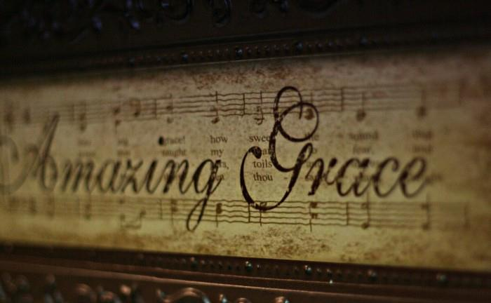
Amazing grace! How sweet the sound
that saved a wretch like me!
I once was lost, but now am found;
was blind, but now I see.
'Twas grace that taught my heart to fear,
and grace my fears relieved;
how precious did that grace appear
the hour I first believed.
Through many dangers, toils, and snares,
I have already come;
'tis grace hath brought me safe thus far,
and grace will lead me home.

Slide 3
The biblical doctrine of Grace
An important doctrine
A misunderstood doctrine
A misapplied doctrine
Romans 6:1 What shall we say then? Shall we continue in sin, that grace may abound?

Slide 5
GRACE
The word “grace” has a broad range of meaning in the New Testament
The doctrine of “grace” is not as flexible
God’s grace is His favor toward us, something undeserved, something that cannot be earned or purchased
Sometimes shorted to “unmerited favor”

Slide 6
Acts 20:24 But I hold not my life of any account as dear unto myself, so that I may accomplish my course, and the ministry which I received from the Lord Jesus, to testify the gospel of the grace of God.
Acts 20:32 And now I commend you to God, and to the word of his grace, which is able to build you up, and to give you the inheritance among all them that are sanctified.
1 Peter 1:10 Concerning which salvation the prophets sought and searched diligently, who prophesied of the grace that should come unto you:

Slide 7
Acts 15:11 But we believe that we shall be saved through the grace of the Lord Jesus, in like manner as they.
Romans 5:2
through whom also we have had our access by faith into this grace wherein we stand; and we rejoice in hope of the glory of God.

Slide 8
Ephesians 1:6 to the praise of the glory of his grace, which he freely bestowed on us in the Beloved:
Ephesians 1:7 in whom we have our redemption through his blood, the forgiveness of our trespasses, according to the riches of his grace,
Ephesians 2:5 even when we were dead through our trespasses, made us alive together with Christ (by grace have ye been saved),
Ephesians 2:7 that in the ages to come he might show the exceeding riches of his grace in kindness toward us in Christ Jesus:
Ephesians 2:8 for by grace have ye been saved through faith; and that not of yourselves, it is the gift of God;

Slide 9
Philippians 1:7 even as it is right for me to be thus minded on behalf of you all, because I have you in my heart, inasmuch as, both in my bonds and in the defence and confirmation of the gospel, ye all are partakers with me of grace.
2 Timothy 1:9 who saved us, and called us with a holy calling, not according to our works, but according to his own purpose and grace, which was given us in Christ Jesus before times eternal,
Titus 2:11 For the grace of God hath appeared, bringing salvation to all men

Slide 10
The Grace-Unity Controversy
Formerly known as “unity in diversity”
Characterized by the following slogans
(1) "Accentuate the positive, and eliminate the negative,"
(2) "Preach the man and not the plan,"
(3) "Preach Christ, and not the church."
An insidious teaching that has led the faith of many onto the rocks of shipwreck

Slide 11
Carl Ketcherside
.. The unity of the body is a unity in diversity" ("The Body of Christ, " Mission Messenger, Vol. 34, No. 10, p. 145).
"I want to make my own position clear. I want to do so now! ... My creed is Jesus Christ! My basis of union is Jesus Christ! My test of fellowship is Jesus Christ! My criterion for communion is Jesus Christ! I have no other creed, and I want no other. I reject here and now, once and for all, any plea for unity based upon conformity to any metaphysical or philosophic deductions, or predicated upon the universal acceptance of any speculation or opinion elevated to doctrinal basis" (Mission Messenger, Vol. 33, No. 9, p. 139).

Slide 12
This is what has been rejected
Ephesians 4:1-6 I therefore, the prisoner in the Lord, beseech you to walk worthily of the calling wherewith ye were called, 2 with all lowliness and meekness, with longsuffering, forbearing one another in love; 3 giving diligence to keep the unity of the Spirit in the bond of peace. 4 There is one body, and one Spirit, even as also ye were called in one hope of your calling; 5 one Lord, one faith, one baptism, 6 one God and Father of all, who is over all, and through all, and in all.

Slide 13
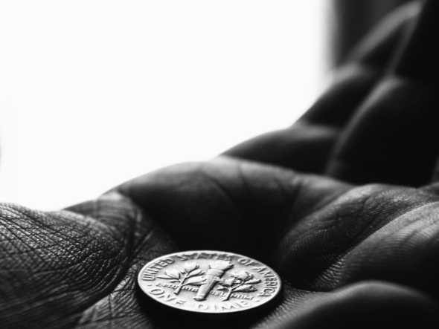
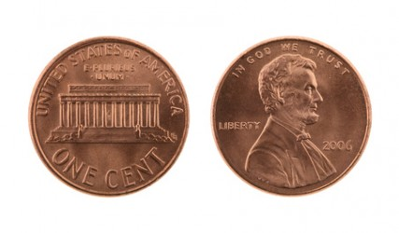
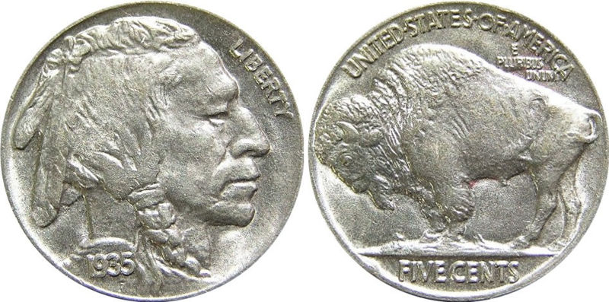
Understanding Error
Error often is the result of a failure to harmonize competing (?) scriptures
The problem illustrated: there are two sides to every coin

Slide 14
Looking at only one side of an issue
Much error is the result of not examining all the scriptures that pertain to a particular area of doctrine
Some obvious examples
Faith only
Baptism
Divorce and remarriage
Grace-unity (unity in diversity)

Slide 15
The doctrine of salvation
Believe
Not of works
Baptism unnecessary
Certain passages denied:
Mark 16:16
Acts 2:38
Obey
Works of obedience
Baptism essential
All scripture harmonized:
Ephesians 2:8-9
Acts 16:30-33
vs.

Slide 17
An Obedient Faith
PROMISES
COMMANDS
Faith = believing (trusting)
Passive in nature
One believes a promise, or trusts something to be true
Obedience = doing, or in some cases NOT doing
Active in nature
One obeys a command

Slide 19
Divorce and Remarriage
Error results from mishandling the information available in the scriptures
Some set the teaching of Jesus against the teaching of Paul (when in truth they harmonize)
Ex. – Matthew 19:9 vs. Romans 7:3
Some will isolate preferred passages
While ignoring troublesome passages

Slide 20
Harmony of Truth
All truth in the scriptures harmonize
Any interpretation of a passage that puts it in conflict with the clear interpretation of another passage needs to be re-examined
Consider Matthew 19:9 and Romans 7:2-3
WHO is restricted from remarriage?

Slide 21
Marrying the Divorced
Matthew 19:9 And I say unto you, Whosoever shall put away his wife, except for fornication, and shall marry another, committeth adultery: and he that marrieth her when she is put away committeth adultery.
forbidden

Slide 22
Restricted by God’s Word
Those who have been divorced (put away) need divine permission to remarry
You cannot assume a permission in Romans 7:2-3 allowing divorced people to remarry
Such a presumption overturns the specifically stated restriction in the teaching of Jesus – Luke 16:18, Matthew 19:9 et al

Slide 23
The Conflict
Jesus says the man who divorces his wife for any reason CANNOT remarry
Some use Romans 7:2-3 to say that this man CAN indeed remarry
This view NULLIFIES the restriction Jesus placed on this man
He is set free by definition
This View
Is DRIVEN by a DEFINITION: Adultery is a sin against the bond

Slide 24
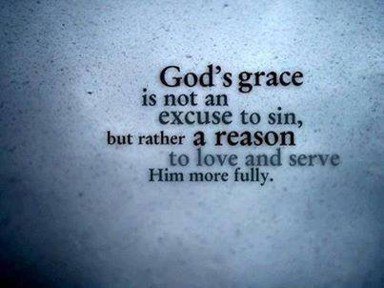
Grace, Unity & Obedience
Some are willing to elevate passages that emphasize “grace” to the neglect of passages that emphasize truth, obedience, church discipline and law.
The purpose = to provide an artificial platform for unity in spite of great differences in faith and practice.

Slide 25
Our Fellowship
Grace-unity advocates applaud their readiness to associate with false brethren, denominationalists, and even heretics because in their view “grace covers it”
The primary basis for such association is the idea that “we all love Jesus”.
Error, ignorance, sinfulness will not be a barrier to our fellowship in Christ as long as you love Jesus
God’s grace does not need any help
1 Corinthians 5:1-2
It is actually reported that there is fornication among you, and such fornication as is not even among the Gentiles, that one of you hath his father's wife. 2 And ye are puffed up, and did not rather mourn, that he that had done this deed might be taken away from among you.

Slide 26
Isolated Elements of Truth
FAITH ALONE
GRACE ALONE
WORKS ALONE
When you isolate one aspect
of truth, you do not attain
To the WHOLE truth of God
Psalms 119:160
The sum of thy word is truth;
And every one of thy righteous
ordinances endureth for ever.

Slide 27
Grace vs. Law
When trying to understand “law” in Romans…
2 Peter 3:15-16 And account that the longsuffering of our Lord is salvation; even as our beloved brother Paul also, according to the wisdom given to him, wrote unto you; 16 as also in all his epistles, speaking in them of these things; wherein are some things hard to be understood, which the ignorant and unsteadfast wrest, as they do also the other scriptures, unto their own destruction.

Slide 28
2 Peter 3:17-18
17 Ye therefore, beloved, knowing these things beforehand, beware lest, being carried away with the error of the wicked, ye fall from your own stedfastness.
18 But grow in the grace and knowledge of our Lord and Saviour Jesus Christ. To him be the glory both now and for ever. Amen.

Slide 29
Law Keeping
Law keeping in both the OT and the NT puts man in a “precarious” situation with God
James 2:10 -11 For whosoever shall keep the whole law, and yet stumble in one point, he is become guilty of all. 11 For he that said, Do not commit adultery, said also, Do not kill. Now if thou dost not commit adultery, but killest, thou art become a transgressor of the law.

Slide 30
All are Guilty
Romans 3:10-12 as it is written, There is none righteous, no, not one; 11 There is none that understandeth, There is none that seeketh after God; 12 They have all turned aside, they are together become unprofitable; There is none that doeth good, no, not, so much as one:
Romans 3:23 for all have sinned, and fall short of the glory of God;

Slide 31
There has always been law
Romans 5:12-14 Therefore, as through one man sin entered into the world, and death through sin; and so death passed unto all men, for that all sinned: -- 13 for until the law sin was in the world; but sin is not imputed when there is no law. 14 Nevertheless death reigned from Adam until Moses, even over them that had not sinned after the likeness of Adam's transgression, who is a figure of him that was to come.

Slide 32
Romans 5:18-21
18 So then as through one trespass the judgment came unto all men to condemnation; even so through one act of righteousness the free gift came unto all men to justification of life.
19 For as through the one man's disobedience the many were made sinners, even so through the obedience of the one shall the many be made righteous.
20 And the law came in besides, that the trespass might abound; but where sin abounded, grace did abound more exceedingly:
21 that, as sin reigned in death, even so might grace reign through righteousness unto eternal life through Jesus Christ our Lord.

Slide 33
Grace provides the remedy for sin
All men are guilty of sin (lawlessness)
God is righteous, thus His justice demands a payment (penalty)
We do not have anything to bring that will suffice to atone for our sins
Therefore, God paid the price for us
By His grace we receive this undeserved blessing, a way of salvation through the sacrifice of His Beloved Son, Jesus

Slide 34
All who will be saved
Titus 2:11-14
For the grace of God hath appeared, bringing salvation to all men, 12 instructing us, to the intent that, denying ungodliness and worldly lusts, we should live soberly and righteously and godly in this present world; 13 looking for the blessed hope and appearing of the glory of the great God and our Saviour Jesus Christ; 14 who gave himself for us, that he might redeem us from all iniquity, and purify unto himself a people for his own possession, zealous of good works.
Hebrews 9:15
And for this cause he is the mediator of a new covenant, that a death having taken place for the redemption of the transgressions that were under the first covenant, they that have been called may receive the promise of the eternal inheritance.
will be saved by the Grace of God

Slide 35
Galatians 5:4-6
4 Ye are severed from Christ, ye would be justified by the law; ye are fallen away from grace.
5 For we through the Spirit by faith wait for the hope of righteousness.
6 For in Christ Jesus neither circumcision availeth anything, nor uncircumcision; but faith working through love.
Faith WORKING through love is NOT incompatible with GRACE

Slide 36
Galatians 1:6-9
6 I marvel that ye are so quickly removing from him that called you in the grace of Christ unto a different gospel;
7 which is not another gospel only there are some that trouble you, and would pervert the gospel of Christ.
8 But though we, or an angel from heaven, should preach unto you any gospel other than that which we preached unto you, let him be anathema.
9 As we have said before, so say I now again, if any man preacheth unto you any gospel other than that which ye received, let him be anathema.

Slide 37
2 Corinthians 11:3-4
3 But I fear, lest by any means, as the serpent beguiled Eve in his craftiness, your minds should be corrupted from the simplicity and the purity that is toward Christ.
4 For if he that cometh preacheth another Jesus, whom we did not preach, or if ye receive a different spirit, which ye did not receive, or a different gospel, which ye did not accept, ye do well to bear with him.

Slide 38
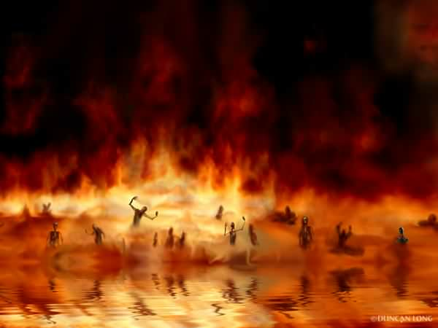
BE NOT DECEIVED
A different gospel
A perverted gospel
Another gospel
Galatians 1:6-9
Accursed
A corrupted message
Another Jesus
A different Spirit
A different Gospel
2 Corinthians 11:3-4

Slide 39
Grace and Church Discipline
Doctrinal error
2 John 9-11
Rev. 2:2,6, 20-24
Romans 16:17
1 Corinthians 1:10 Now I beseech you, brethren, through the name of our Lord Jesus Christ, that ye all speak the same thing and that there be no divisions among you; but that ye be perfected together in the same mind and in the same judgment.
Walking disorderly
2 Thessalonians 3:6, 14
Moral sins
1 Corinthians 5:1, 9-13

Slide 40
1 Peter 5:10 And the God of all grace, who called you unto his eternal glory in Christ, after that ye have suffered a little while, shall himself perfect, establish, strengthen you.
Acts 20:32
And now I commend you to God, and to the word of his grace, which is able to build you up, and to give you the inheritance among all them that are sanctified.

